Slide 1
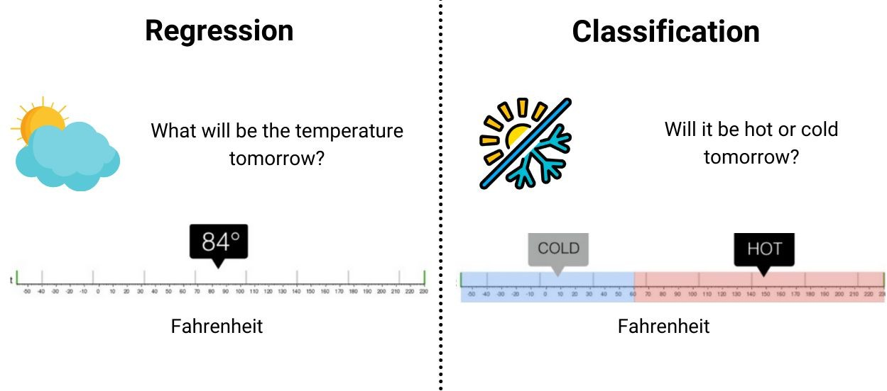
Regression Vs. Classification
Regression is a problem of predicting a continuous numeric value (e.g., a price, a temperature, a score) based on input data.

Slide 2
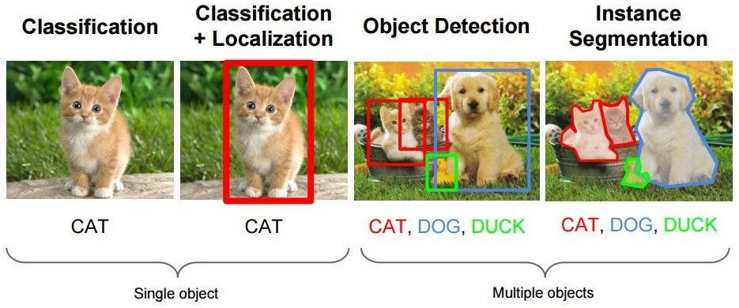
Computer Vision Tasks

Slide 3









Classification
Assigning objects to some pre-existing classes / categories / labels / groups.
Cat
Cat
Binary Classifier
Dog
Multi-Class Classifier
Bird
Dog
Flower
Number of classes = 2
Number of classes = 4

Slide 4
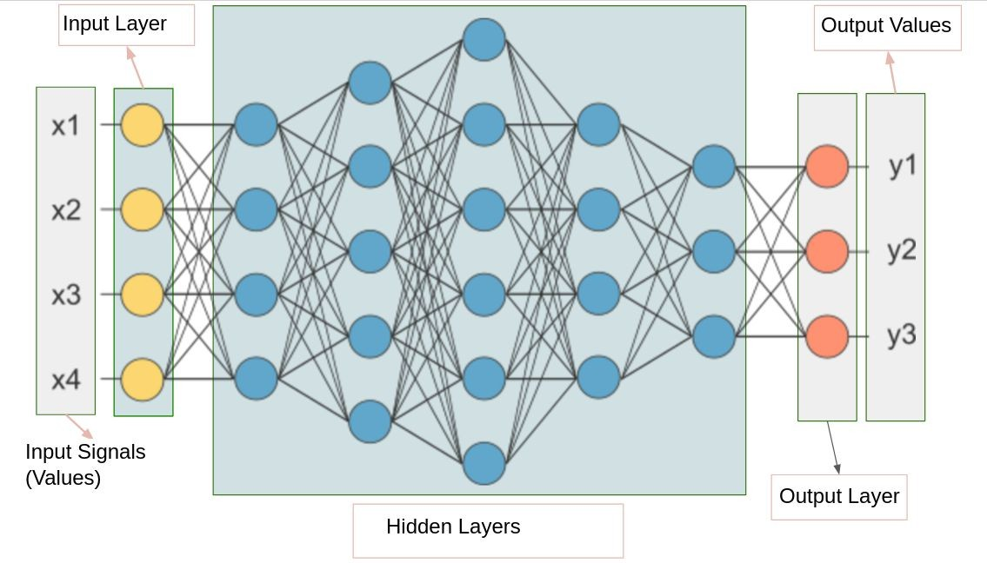
Fully Connected Neural Network (FCNN)
FCNN consists of a series of fully connected layers
It is also known as multi-layer perceptron (MLP).
Image Source: Google Search Engine
13

Slide 5
Fully Connected Layer
A fully connected layer connects every neuron in one layer to every neuron in its previous layer.
An image need to be turned into a vector before feeding into an fully connected layer.
Flatten() is used in Tensorflow.keras
Fully Connected Layer
14

Slide 6
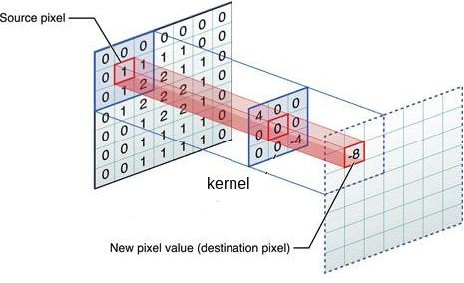
Convolution for Single-Channel Input & Single-Channel Output
Convolution layer adds each element of a feature map to its local neighbors, weighted by the kernel.
Source pixel: 1
Destination pixel: 4x0 + 0x0 + 0x0 + 0x0
+ 1x0 + 2x0 + 0x0 + 1x0 + (-4)x2 = -8
Total number of multiplication for one pixel = kernel_height x kernel_width

Slide 7
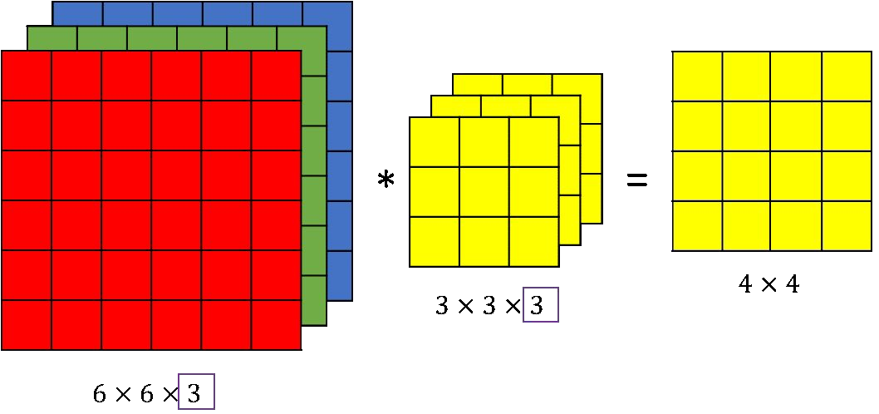
Convolution for Multi-Channels Input & Single-Channel Output
Number of Kernel’s Channels = Number of Input Feature Map’s Channels

Slide 8
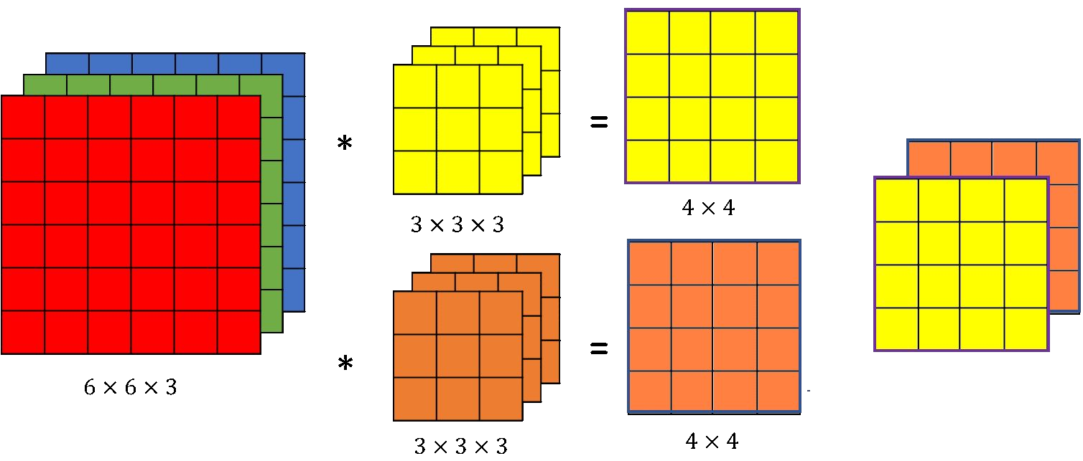
Convolution for Multi-Channels Input & Multi-Channels Output
Number of Kernels = Number of Output Feature Map’s Channels

Slide 9
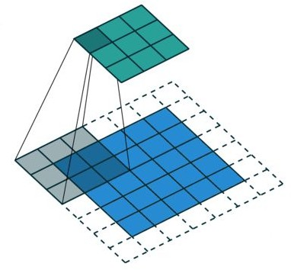
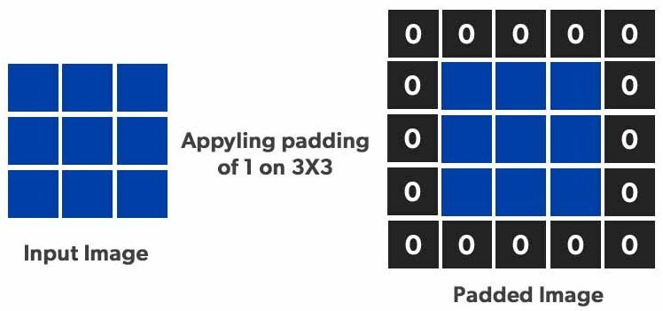
Padding
Padding preserves the spatial size of the input so that the output after convolution remains the same size or desired size.

Slide 10
Steps of Traditional Machine Learning
Data Preparation:
Data Collection
Data Splitting
Data pre-processing
Data Cleaning
Data Transformation
Feature Extraction:
Identify Relevant Features
Extract and Transform Features
Training Classifier:
Model selection
Searching for optimum parameters
Evaluation
Estimate metrics using test set

Slide 11
End-to-End Learning
End-to-end learning or end-to-end training, is a machine learning model that:
learns directly from raw input data to produce a desired output, without the need for manual feature engineering or pre-processing steps.
gets popularity in deep learning.
bypasses few steps of traditional learning such as data pre-processing, feature extraction.

Slide 12
Kernel
In computer vision, kernel is a (usually) small matrix of numbers that is used in image convolutions.
Different sized kernels containing different patterns of numbers produce different results under convolution.
Generally, small odd numbers such as 3, 5, or 7 are used as the size of a kernel.
Popular human-decided kernels:
Gaussian Blur Kernel
Laplacian Kernel
Prewitt Kernel
Sobel Kernel

Slide 13
Feature Map
A feature map:
is a 2D matrix in a hidden layer
represents the output of a convolutional layer
captures specific features or patterns in the input data.
In a CNN:
Instead of human-decided kernels/filters, different automatically learned kernels/filters are used to generate different feature maps

Slide 14
Activation Function
An activation function is a mathematical equation that determines how much data should be passed from a neuron to the next neuron.
It is the function that is applied on the weighted sum of the input of the neuron, i.e., it is 𝒈(𝒖).
Generally, it is a nonlinear function for a neuron in the hidden layer and linear/non-linear function for neurons in the output layer.
A linear activation function, also known as "no activation" or "identity function," is directly proportional to the input.
Popular non-linear activation functions are:
Sigmoid, Tanh, ReLU, ELU, Softmax

Slide 15
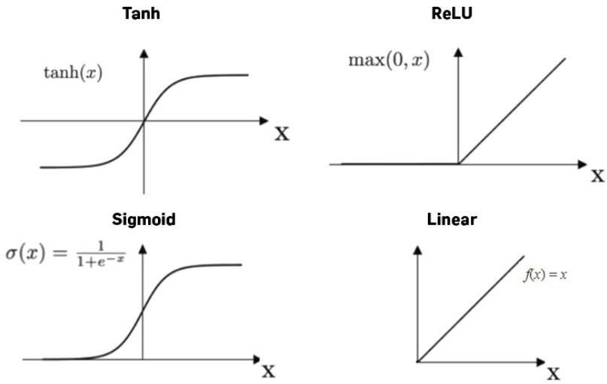
Activation Functions
Linear activation function in the output layer generally used for regression problem.
Depending on the range of output values, we need to choose activation function.
18

Slide 16
Some Popular Activation Functions
Sigmoid
Also known as the logistic activation function
Often used for models that predict probability as an output.
Its curve looks like an S-shape and exists between 0 and 1.
Suffers from saturating gradients problem.
Hyperbolic tangent (Tanh)
Has stronger gradients than the sigmoid function, and its output ranges from -1 to +1.
Helps the learning algorithm converge faster.
Rectified linear unit (ReLU)
A non-saturating function, meaning it doesn't become flat at the extremes of the input range.
It is faster than sigmoid and tanh.
Softmax
Converts vectors of real numbers into a probability distribution.
Each output value represents the probability that the input belongs to a specific class.

Slide 17
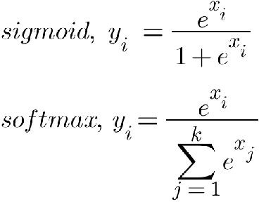
Activation Functions for Classification
In output layer, generally:
Sigmoid is used for binary classification
Softmax is used for multi-class classification
Both generate values in the range of 0-1. Summation of softmax values is 1.
Summation of sigmoid values in a classifier does not need to be 1.
20

Slide 18
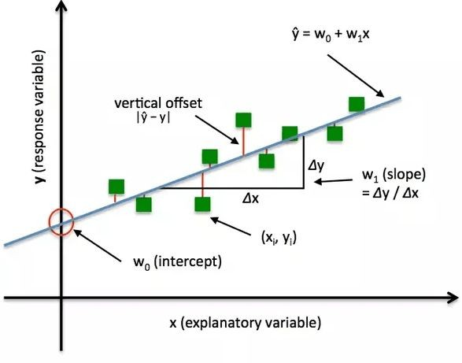
Loss
Error is a measurement of the difference between the predicted output of the model and the actual output.
Loss is the weighted error.
Different types of loss:
Absolute loss: |ŷ - y|
Squared loss: (ŷ - y)²
Log loss: - y.log(ŷ)

Slide 19
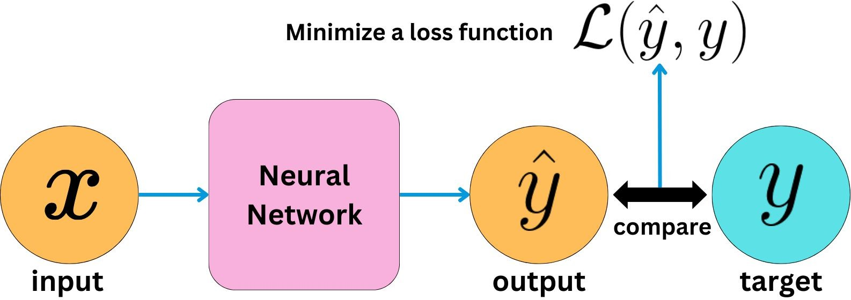
Loss Function
A loss function is a function which estimates the total loss of all data samples.
It is used to find optimum values of parameters of a neural network during training.
It is a function of parameters.
Different ways of writing:
J(𝜔); L(𝜃|x); ℓ(𝜔) ; ℒ(ŷ - y);

Slide 20
Different Loss Functions
Different loss functions penalizes wrong predictions differently
Popular losses:
Regression:
Mean-Squared Error (MSE)
Mean Absolute Error (MAE)
Classification:
Binary Cross-Entropy
Categorical Cross-Entropy
4

Slide 21
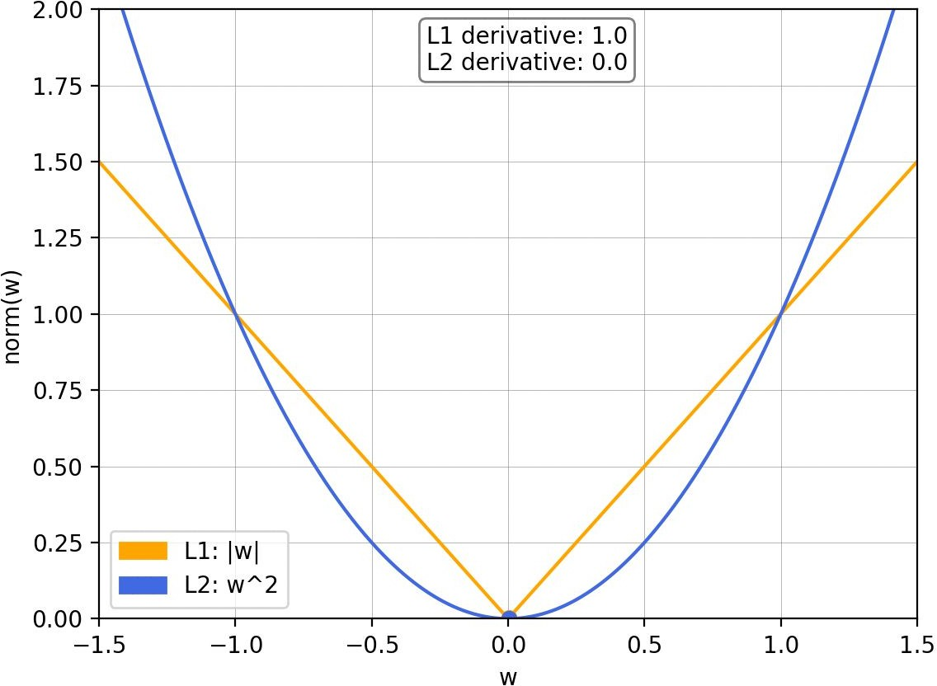
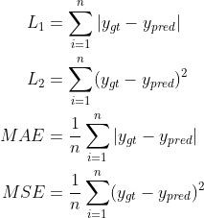
L1 & L2 Loss
Absolute Loss is also known as L1 loss
Squared Error Loss is also known as L2 loss

Slide 22
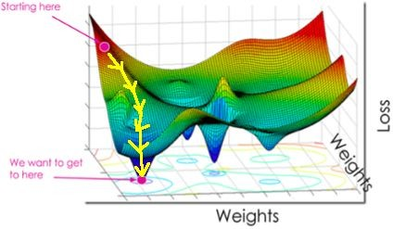
Training Neural Network
During training we try to find the parameter set for which loss is minimum.
Starting at random values, we update parameters by gradient descent algorithm
Image Source: Google Search Engine
13

Slide 23
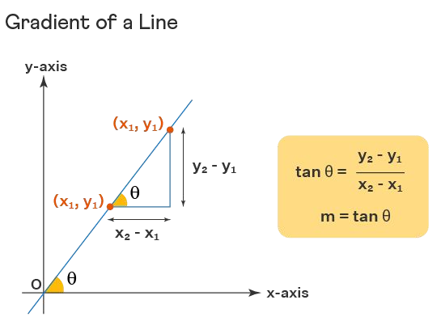
Gradient
Gradient (GD) means the change in the value of a quantity with change in a given variable
the sign of a GD represents the direction of greatest change in a scalar function

Slide 24
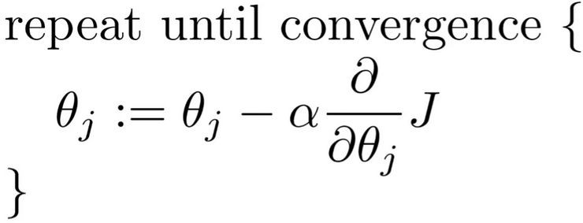
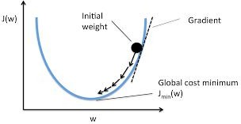
Gradient Descent Algorithm

Slide 25
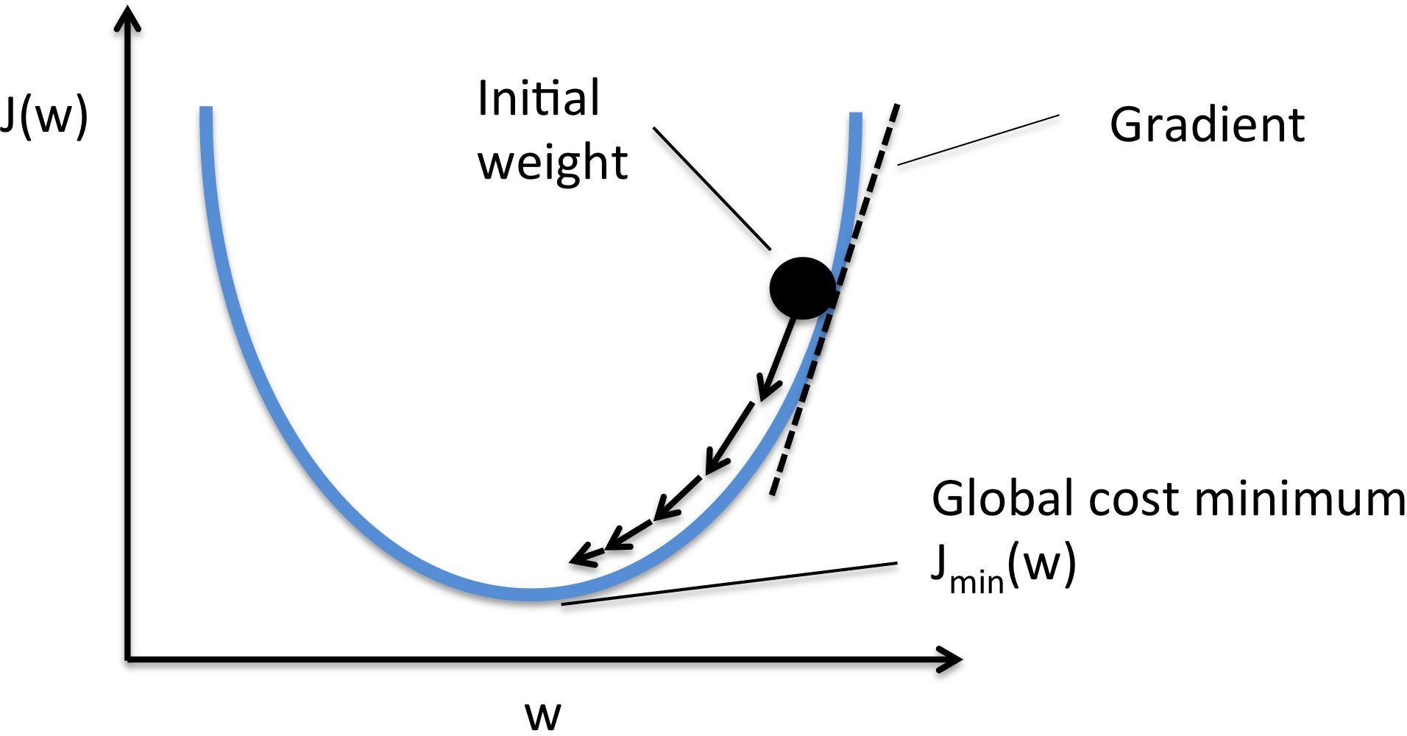

Gradient Descent Algorithm
Initialize parameters randomly
Estimate outputs for inputs in a forward pass
Estimate loss
Estimate gradient of the loss function with respect to all parameters
Move parameters in the opposite direction of gradient
Repeat these steps until loss is minimum

Slide 26
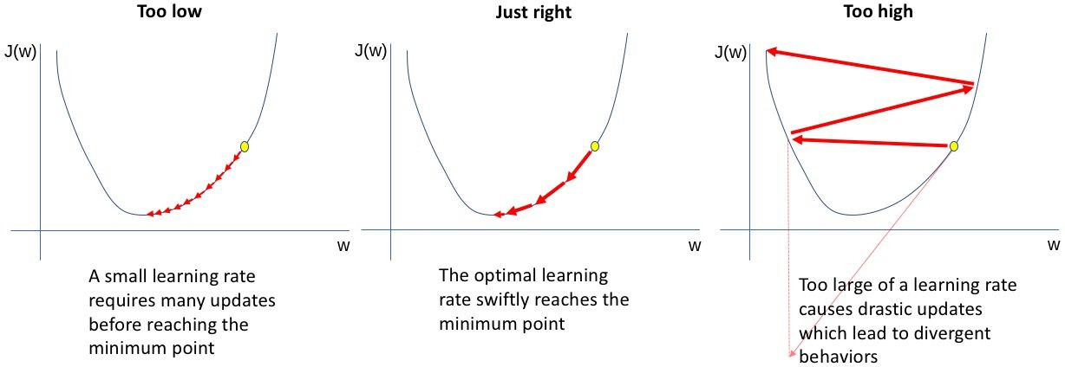
Effect of Learning Rate, α

Slide 27
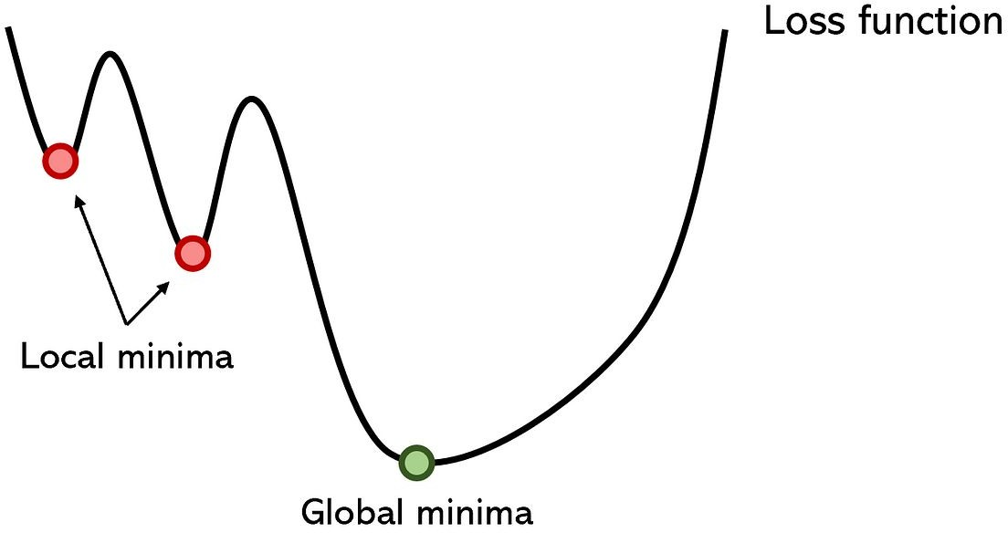
Local Vs. Global Minima
Local Minimum
A point where a function's value for a variable parameter is smaller than nearby points, but possibly larger than at a distant point.
Global Minimum
A point where a function's value for a variable parameter is smaller than at all other feasible points
Our target is to reach the global minima, but unfortunately we end up at a local minima.

Slide 28
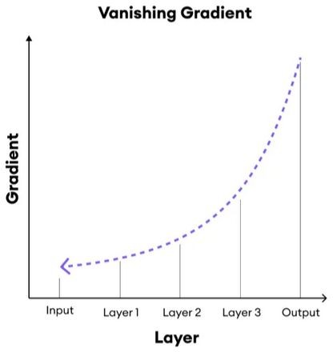
Vanishing Gradient
gradients often get smaller and smaller and approach zero
therefore, the weights of the initial or lower layers nearly unchanged
as a result, the gradient descent never converges to the optimum
model learns very slowly and perhaps the training stagnates at a very early stage just after a few iterations

Slide 29
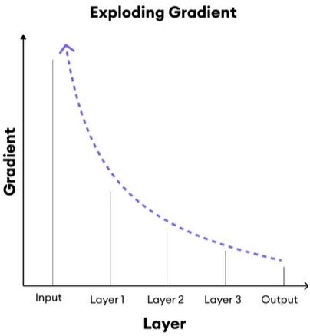
Exploding Gradient
gradients keep on getting larger and larger
it causes very large weight updates
an exponential growth in the model parameters
model weights may become large during training
it causes the gradient descent to diverge
model experiences avalanche learning

Slide 30
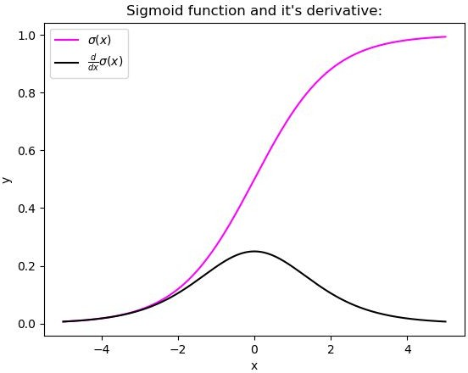
Ways to Handle GD Vanishing and Explosion
Proper weight initialization
Glorot / He / He initialization
Non-saturating Activation Functions
ReLU
Batch normalization
Zero centering and normalizing inputs
Gradient clipping to mitigate gradient explosion
clip all the partial derivatives of the loss with respect to each trainable parameter between –1.0 and 1.0

Slide 31
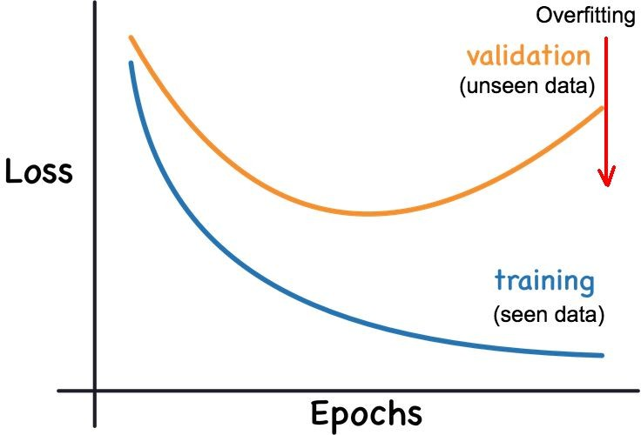
Overfitting
Overfitting occurs when:
the model is so closely aligned to the training data that it does not know how to respond to new data.
the model memorizes training data
Memorizing is not learning

Slide 32
Reasons behind Overfitting
Overfitting can happen because:
Model is too complex; it memorizes very subtle patterns in the training data that don’t generalize well.
Model has too many parameters
The training data size is too small for the model complexity and/or contains large amounts of irrelevant information.
During training model sees a small dataset for too many times i.e., too many epochs were used during training.

Slide 33
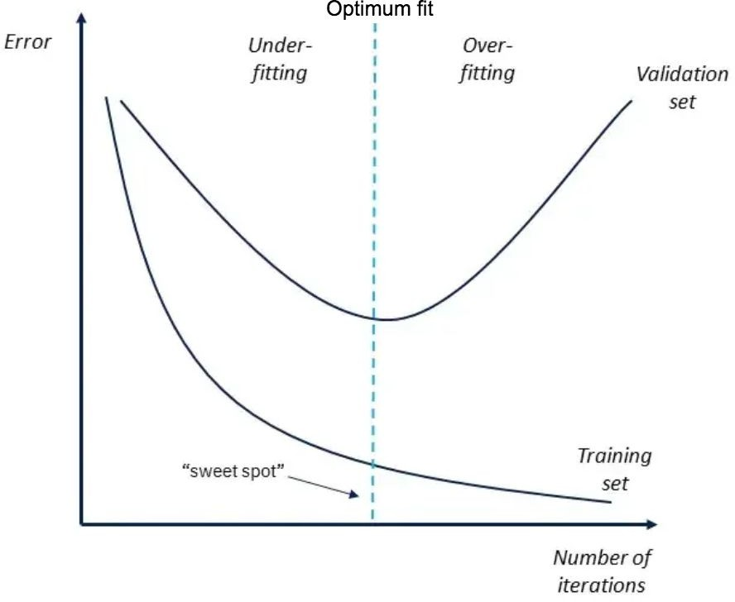
Underfitting
Underfitting is the opposite concept of overfitting
When the prediction error on both the training and validation dataset is high, and the difference between them is very minimal, the model is said to have under fitted.

Slide 34
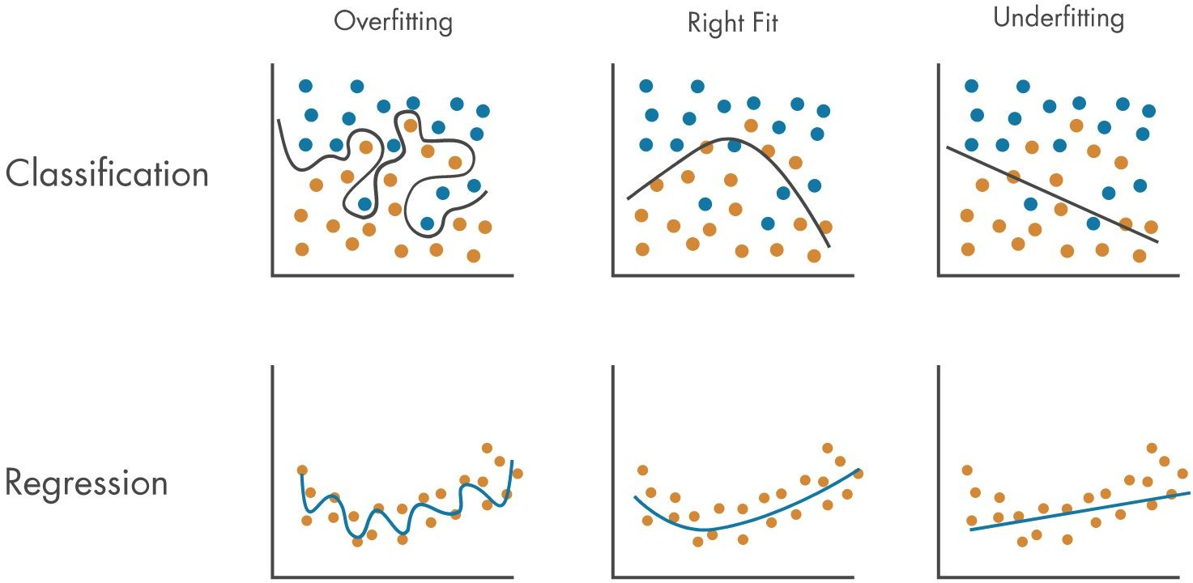
Overfitting - Underfitting in Classification and Regression

Slide 35
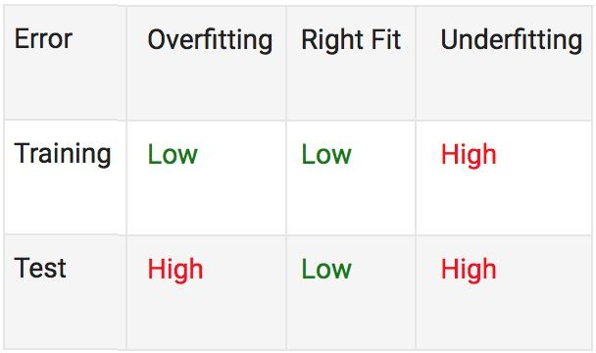
Overfitting vs Underfitting
When only looking at the computed error of a model for the training data, overfitting is harder to detect than underfitting.
More details: https://www.mathworks.com/discovery/overfitting.html

Slide 36
Downsampling Layer
A downsampling layer reduces the dimensionality of the features at cost of a some loss in information.
Convolution layer with larger strides and no padding
It is a learnable operation, whereas pooling is a fixed operation
Some research works showed better performance
Different pooling layers
Max pooling
Average pooling
Global average pooling

Slide 37
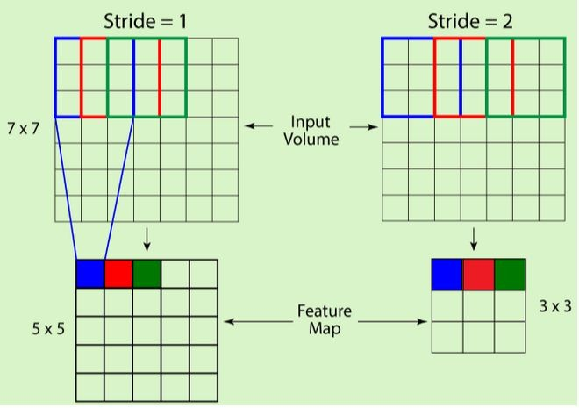
Downsampling by Convolutional Layer
Without padding, setting appropriate stride value, we can downsample feature map by convolution.

Slide 38
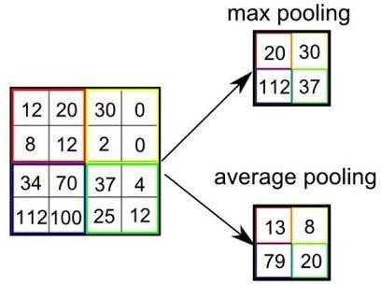
Pooling Layer
It reduces the spatial dimensions of feature maps, thereby:
decreases computational cost
makes the network more robust to variations in the input
Different Types of Pooling Layers:
Max Pooling
Average Pooling
Global Pooling
Stochastic Pooling (not very common)

Slide 39
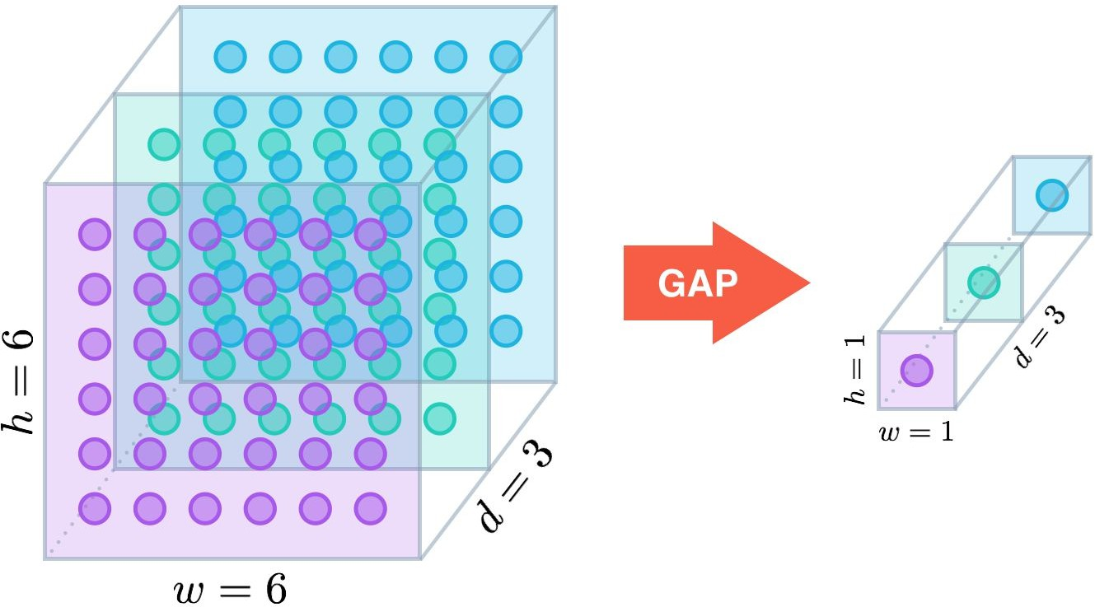
Global Pooling
It reduces the spatial dimensions of feature maps to a single value per channel.

Slide 40
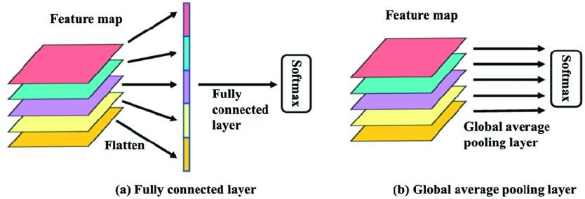
Usage of GAP

Slide 41
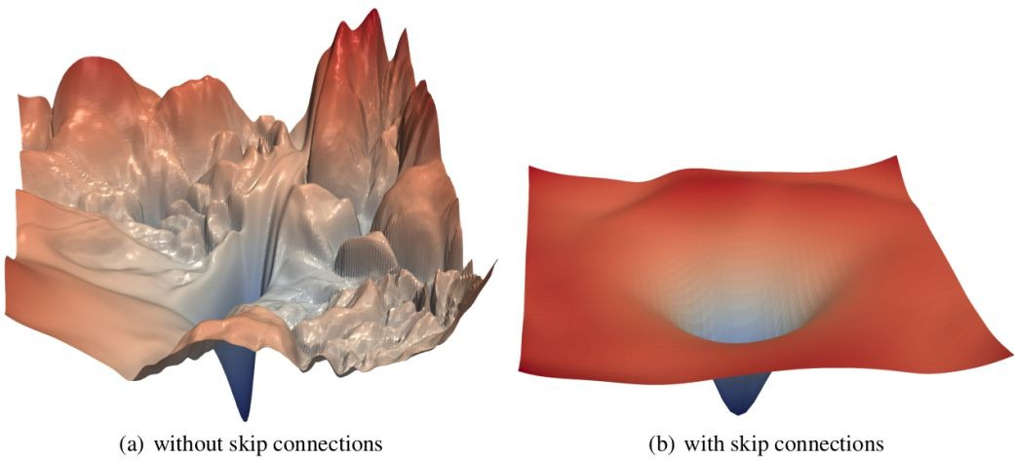
Skip Connections
Skip connections allow CNNs to bypass some layers and connect directly to deeper or shallower ones.
Skip connections lead to:
faster convergence
vanishing gradient problem prevention
loss of information prevention

Slide 42
How to Avoid Overfitting
Model Validation
The error of an overfitted model is low when computed for the training data. We need to test performance of our model on a separate data set (i.e., validation data set) before using real-time application data.
Regularization
Regularization applies either a penalty for complexity or roughness to the model. By introducing additional information into the model, regularization algorithms can deal with multicollinearity and redundant predictors by making the model more parsimonious and accurate.
https://www.youtube.com/watch?v=wNdYpD2YhSk&t=331s

Slide 43
How to Avoid Overfitting
Data Augmentation
When data availability is limited, data augmentation is a method to artificially expand the data points of the training data set by adding randomized versions of the existing data to the data set.
Synthetic Data
Synthetic data generated by generative model can bring variability in available data, increase size of training dataset and reduce overfitting issue to some extent.
Data Clean Up
Data noisiness contributes to overfitting. One common approach to reduce undesired data points is to remove outliers from the data.

Slide 44
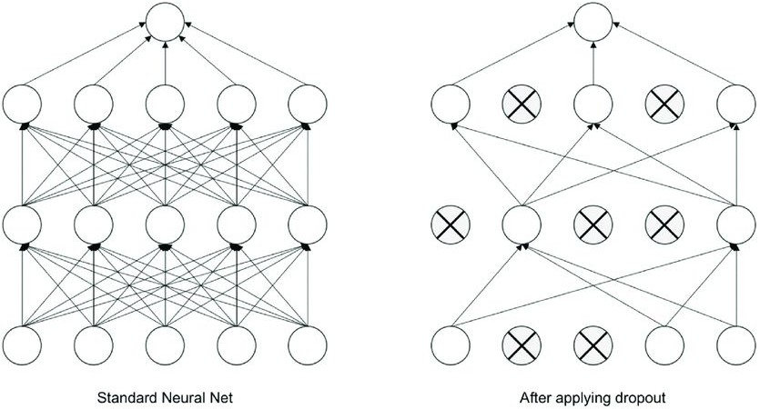
Dropout Layer
In dropout layer:
individual nodes are excluded in various training runs
prevents overfitting
20

Slide 45
Dropout Layer
It activates during training phase only, not in validation and testing phase
Forward Pass:
A certain percentage of neurons in the dropout layer are randomly picked to be "dropped" (deactivated).
The output of the dropped neurons is set to zero, effectively removing them from the network's calculations for that specific iteration.
Backward Pass:
The gradients for the dropped neurons are effectively ignored. They don't contribute to the weight updates.
The gradients for the active neurons are scaled by a factor that accounts for the dropout probability

Slide 46
Derivative
It is a way to measure the rate of change of a function with respect to an independent variable.
It tells us how quickly a function is changing at a specific point.
y = f(x)
x: independent variable
y: dependent variable

Slide 47
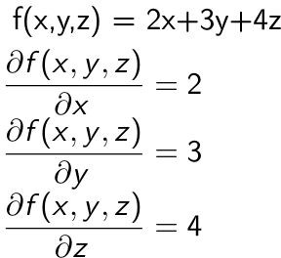
Partial Derivative
It measures the rate of change of a multivariable function
It is done with respect to one of its variables, while holding all other variables constant.

Slide 48


Gradient
It is a vector with partial derivatives of a multivariate function.
For a function of two variables, i.e.,
Gradient:

Slide 49
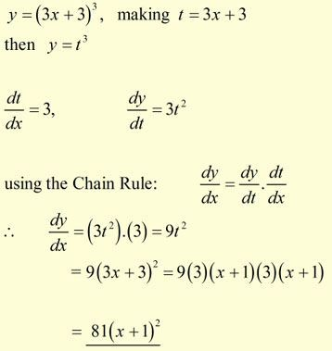
Chain Rule
It is a formula for finding the derivative of a composite function.

Slide 50
Backpropagation Algorithm
It is used for efficient weight adjustments to minimize the error between predicted and actual outputs.
It works by:
calculating the gradient of the loss function with respect to the network's weights.
Propagating error information backward through the network layers

Slide 51
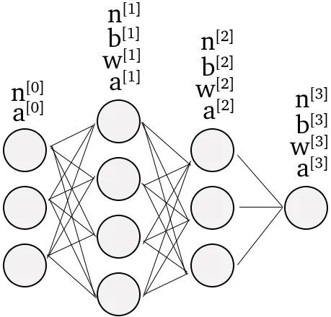
A Simple Reference Neural Network
n: number of neurons
a: vector of activation function
w: matrix of weights
b: vector of biases
Output Layer
Input Layer
Hidden Layers

Slide 52


Formulas
Weighted input to the neurons in layer l,
Activation of layer l,
Say, one neuron’s output y can be 0 or 1. Then cross-entropy cost function is:

Slide 53
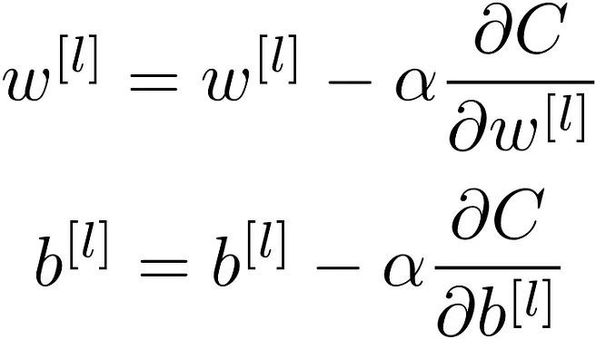
Update Rule
Alpha is the learning rate, which decides how big the updates will happen.

Slide 54
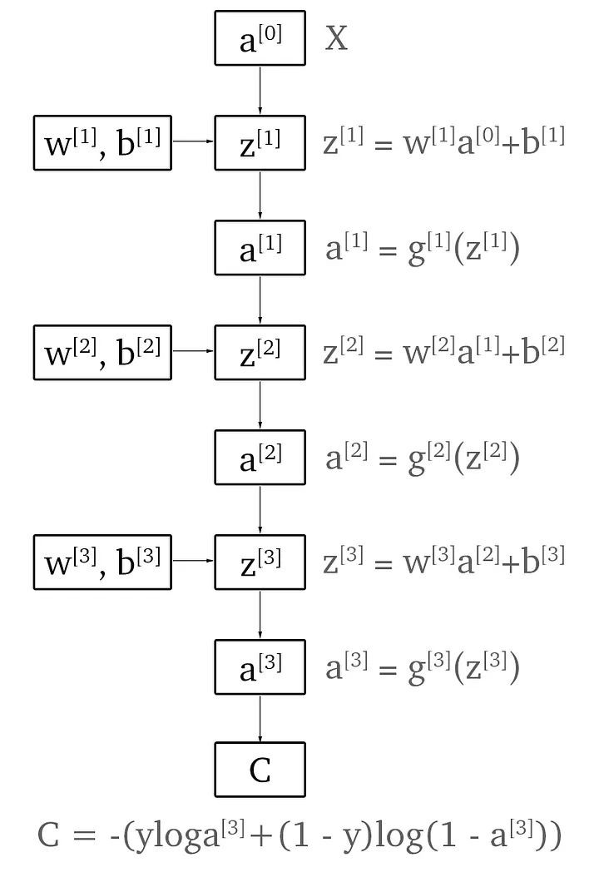
Forward Propagation Computation Graph

Slide 55
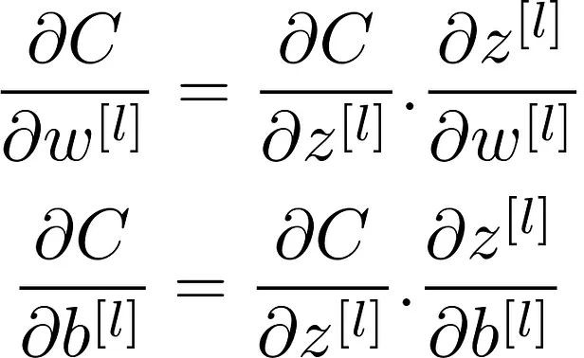
Partial Derivative of C
Partial Derivative of C with respect to parameters of any layer, l

Slide 56
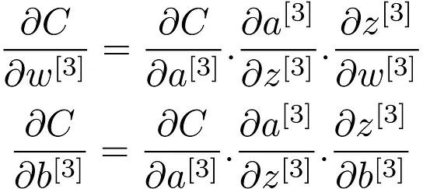
Partial Derivative of C
Partial Derivative of C with respect to parameters of Layer-3

Slide 57
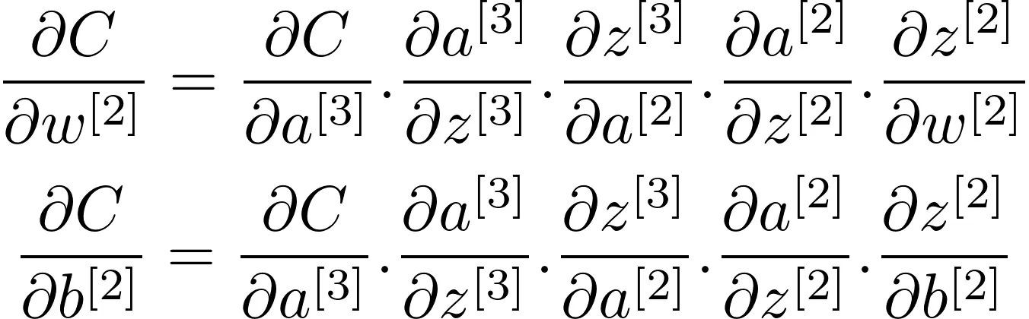
Partial Derivative of C
Partial Derivative of C with respect to parameters of Layer-2

Slide 58
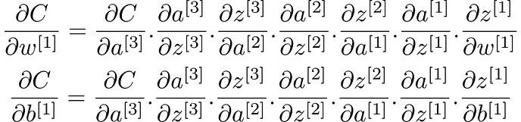
Partial Derivative of C
Partial Derivative of C with respect to parameters of Layer-1

Slide 59
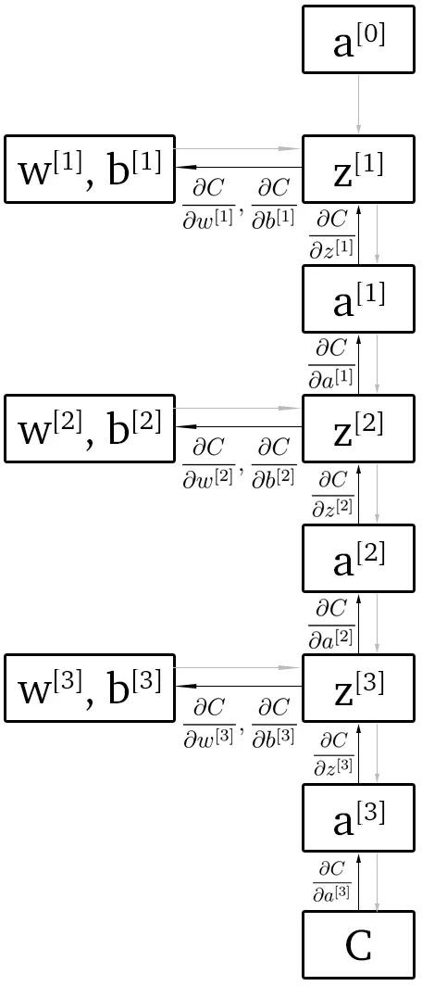
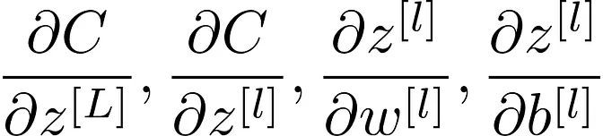
Backpropagation Computation Graph
for calculating the partial derivatives of C with respect to w[l], b[l], we need to calculate:
error information is propagated backward through the network layers for updating the weights

Slide 60
Backpropagation Computation Graph
for calculating the partial derivatives of C with respect to w[l], b[l], we need to calculate:
error information is propagated backward through the network layers for updating the weights

Slide 61
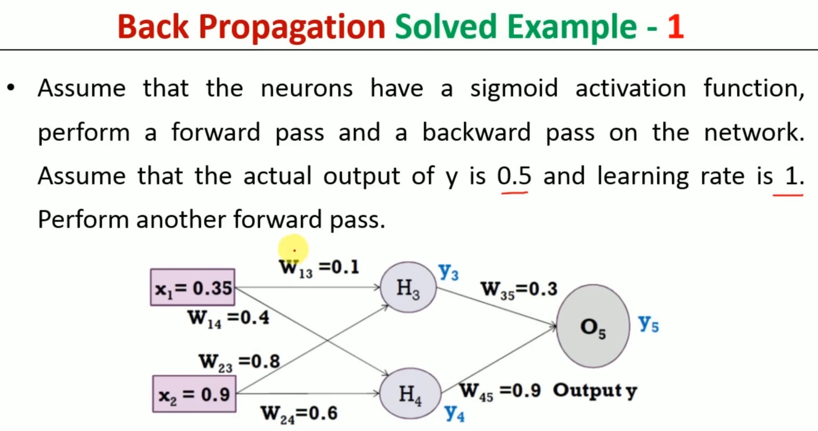

Slide 62
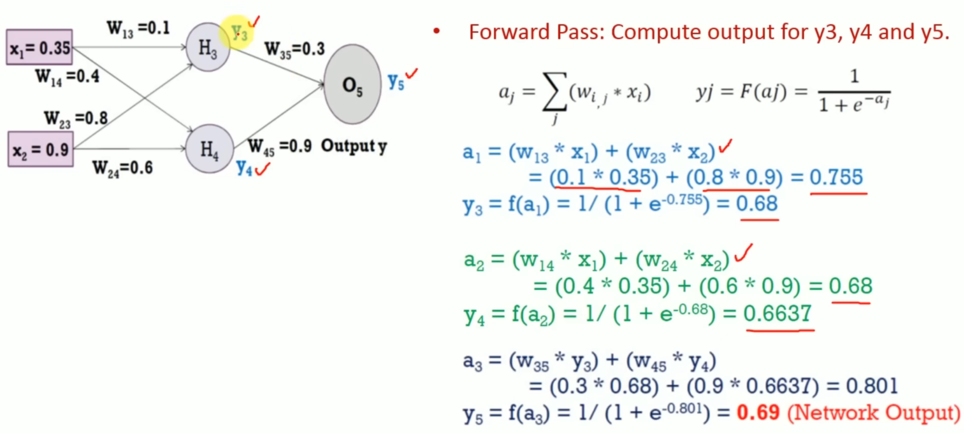
Error=Y_{target} - y5= -019

Slide 63
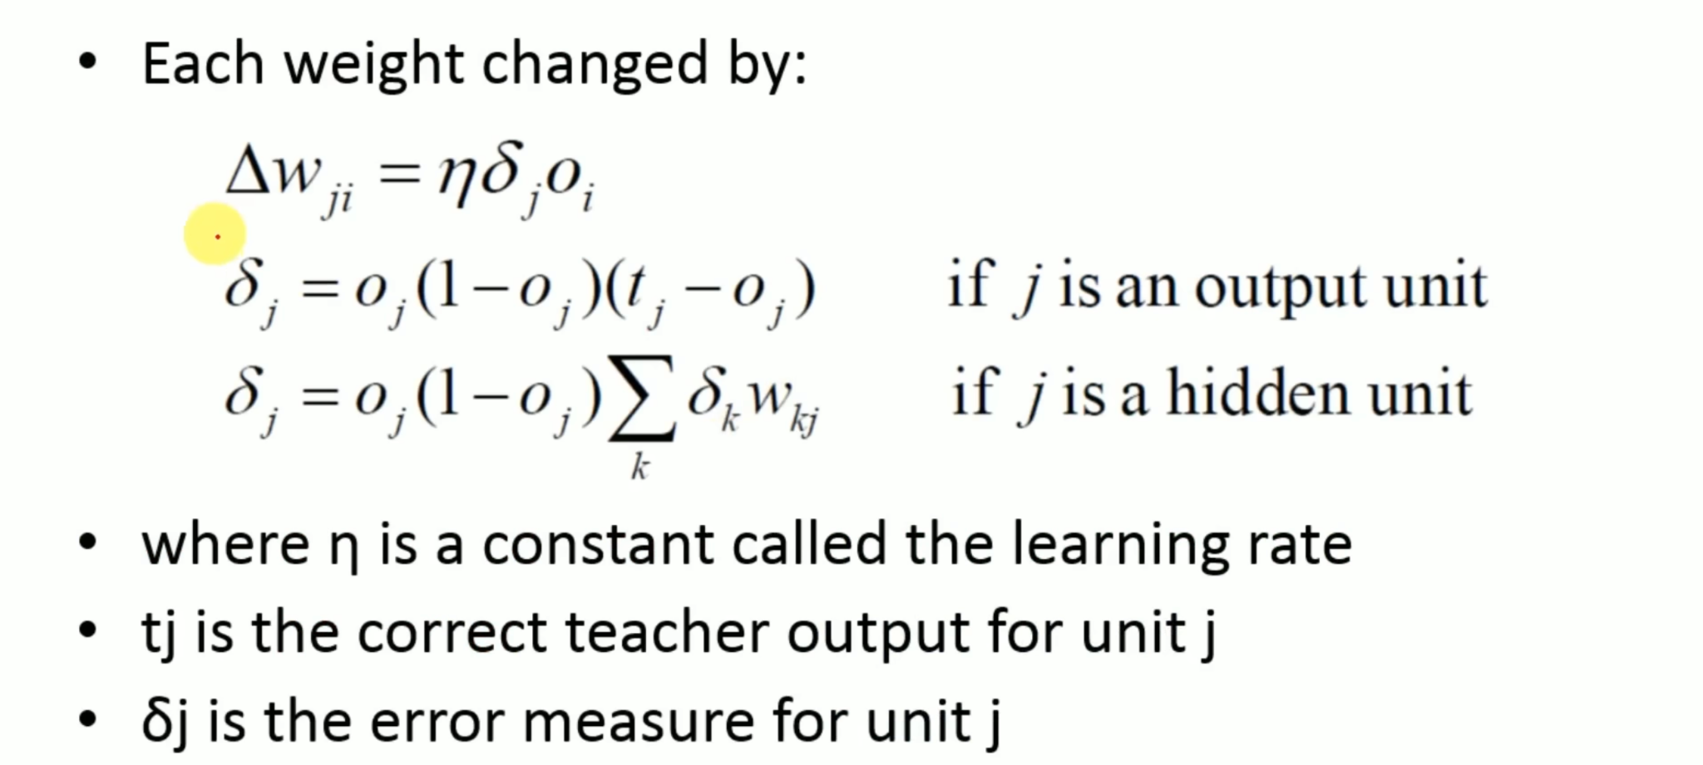
*w_{ij}

Slide 64
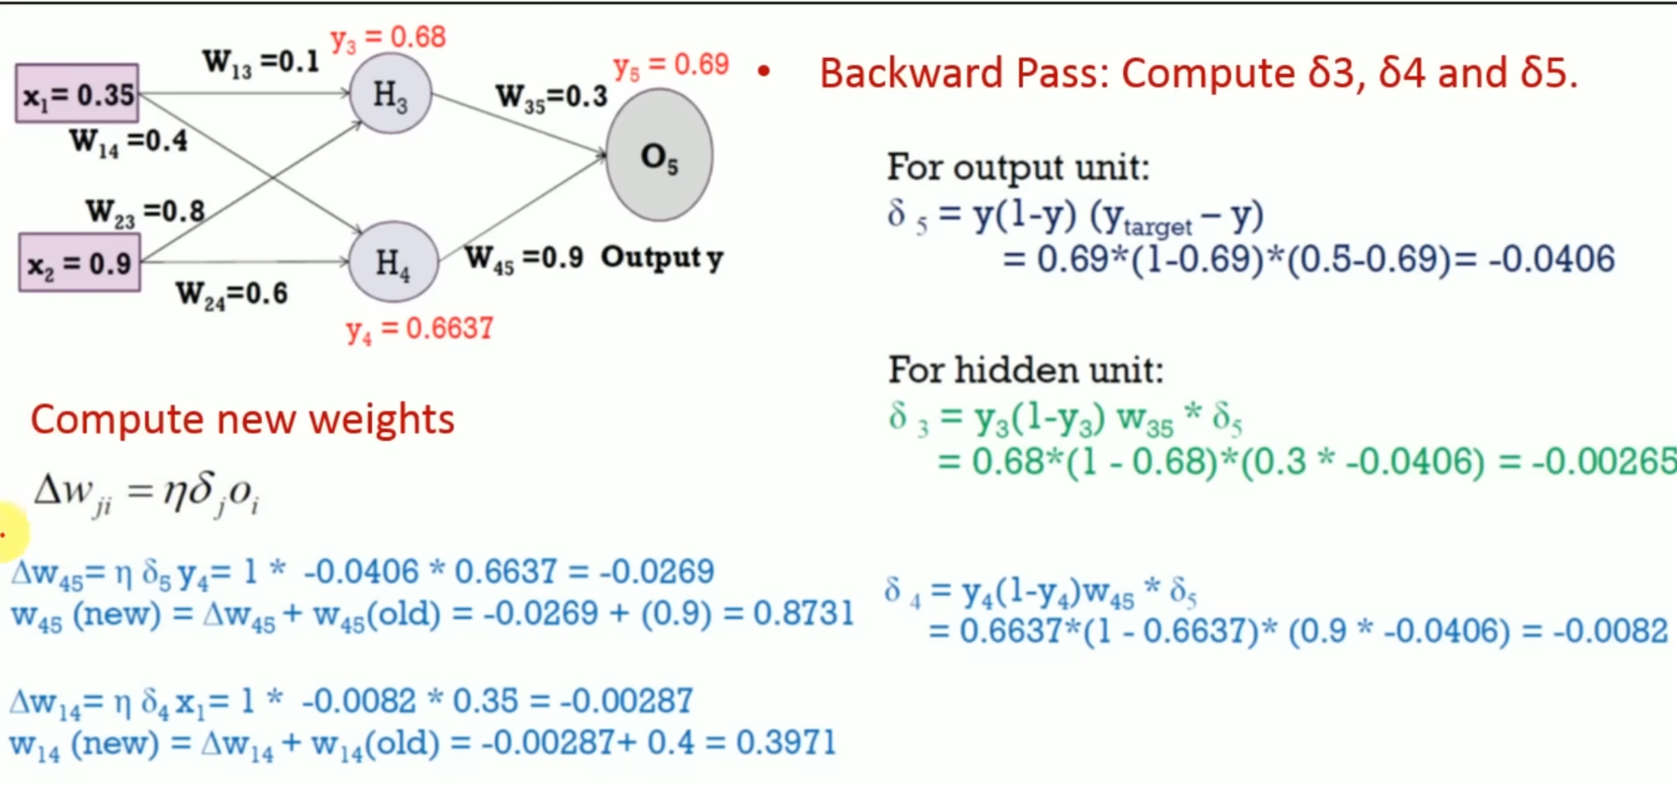

Slide 65
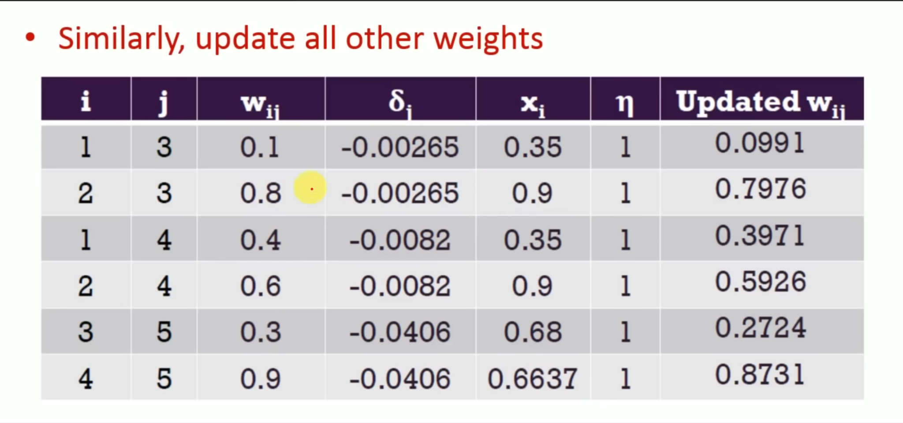

Slide 66


